Slide 1
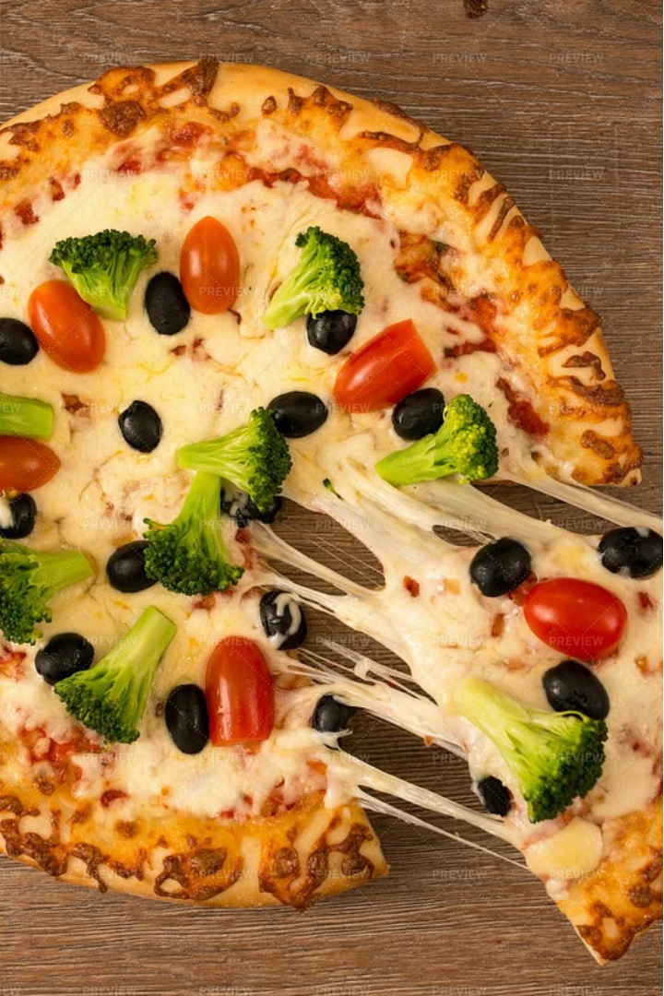
Analyzing Pizza Sales Data
SQL PROJECT PRESENTATION
This presentation will dive into the key insights and findings from an in-depth analysis of pizza sales data. We'll uncover valuable information about customer ordering trends, revenue generation, and the most popular pizza offerings.
BY
Sahithi Dusi

Slide 2

Total Number of Orders Placed
1
Order Volume
2
Benchmark for Growth
3
Operational Planning
The total number of orders placed provides a high-level view of the pizza business's overall activity and demand.
Tracking order volume over time can help identify trends and serve as a benchmark for future growth and performance.
Knowing the total order volume is crucial for planning staffing, inventory, and other operational aspects of the business.

Slide 3




Joining the Necessary Tables
Orders
order_details
pizza_types
pizzas
The orders table contains details about each individual pizza order.
this contains of date and time of the orders and ids of it
This tables contains about the details of category , pizza types, ingredients
The pizzas table consists of the details of size and price

Slide 4
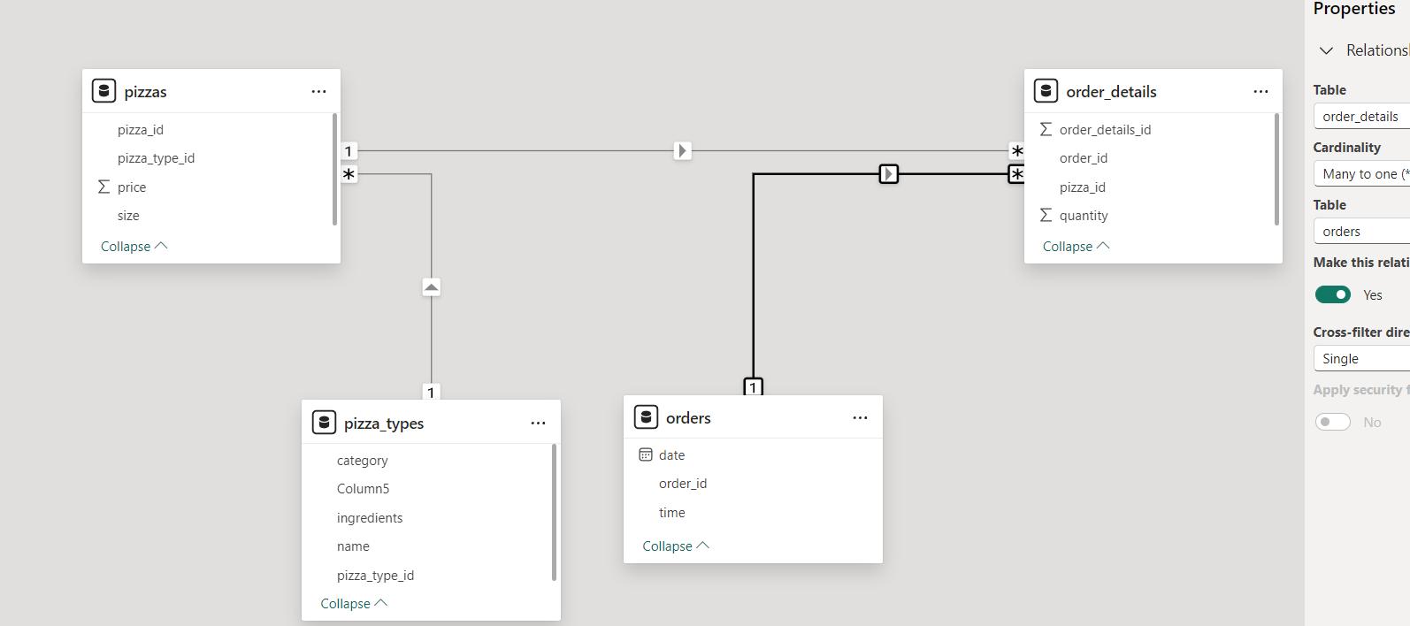
Schema For the Tables

Slide 5
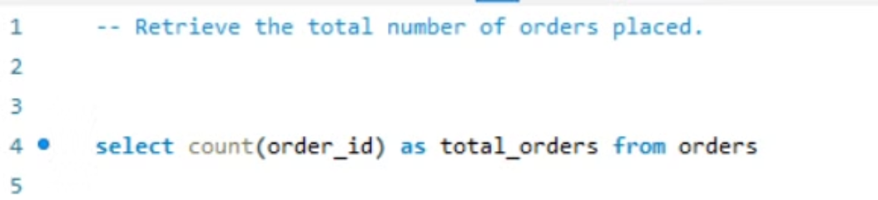
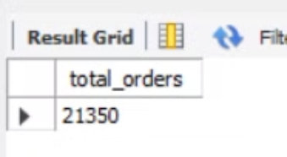
TOTAL NUMBER OF ORDERS PLACED
The total number of orders placed helps in assessing demand, tracking sales trends, and guiding strategic business decisions.
OUTPUT

Slide 6
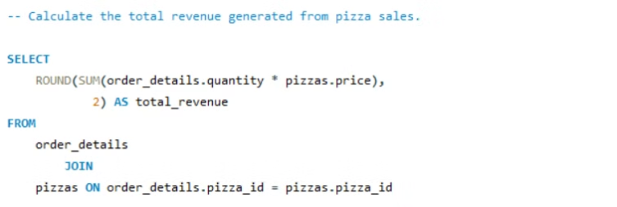
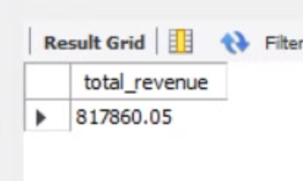

Total Revenue Generated from Pizza Sales
Revenue Insights
Analyzing the total revenue generated from pizza sales gives valuable insights into the financial health and profitability of the business
OUTPUT

Slide 7

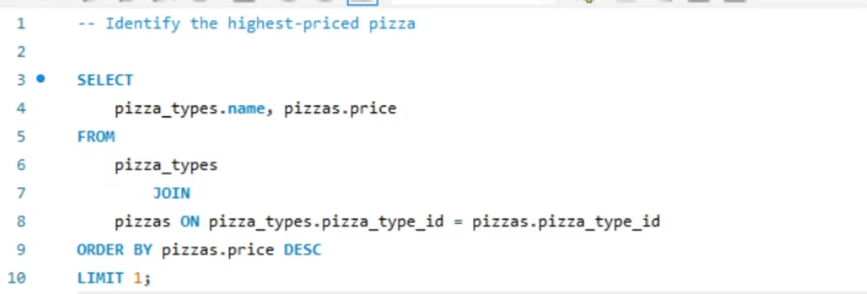
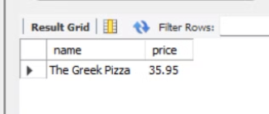
Highest-Priced Pizza
Identifying the highest-priced pizza can reveal insights about customer preferences for premium and specialty menu items.Analyzing the highest-priced pizza can also shed light on the competitive landscape and how the business positions its offerings.

Slide 8
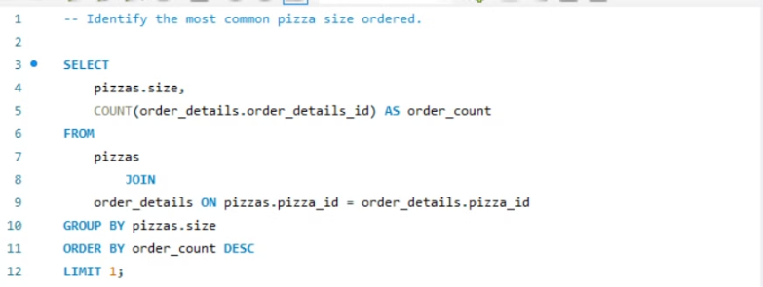
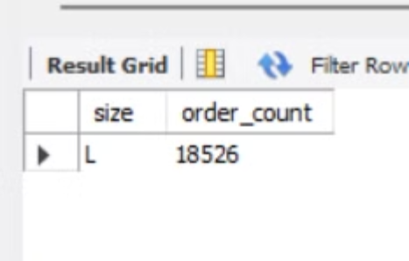
Most Common Pizza Size Ordered
Knowing the most common pizza size ordered helps optimize inventory, tailor marketing strategies, and enhance customer satisfaction by aligning product offerings with customer preferences
OUTPUT

Slide 9
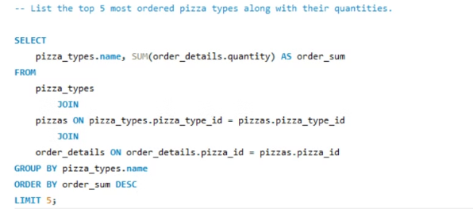
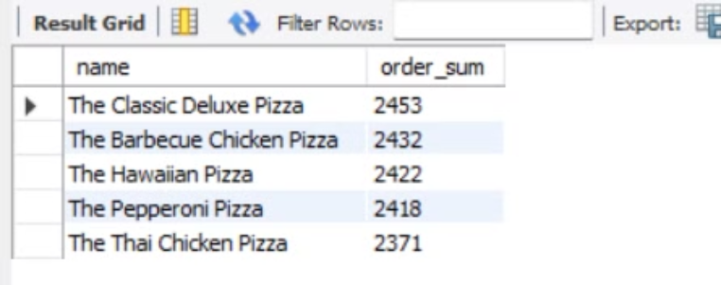
Top 5 Most Ordered Pizza Types
OUTPUT
Understanding the top-selling pizza types provides valuable insights into customer preferences and can inform menu engineering, product development, and marketing strategies.

Slide 10
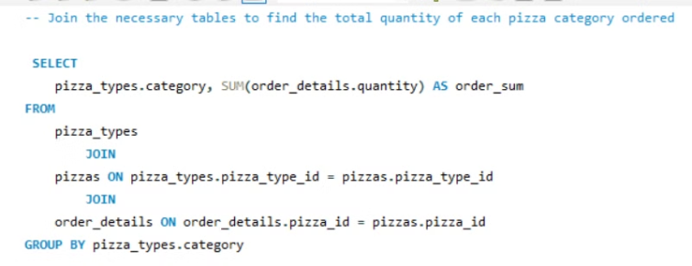
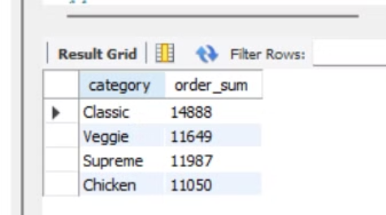
Joining Tables to Analyze Pizza Order Quantities
To understand the total quantity of each pizza category ordered, we need to join the necessary tables in the database. This will allow us to aggregate the order details and identify the most popular pizza types by volume.
OUTPUT

Slide 11
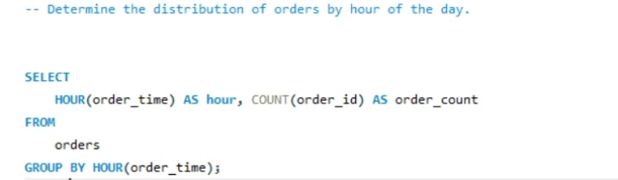
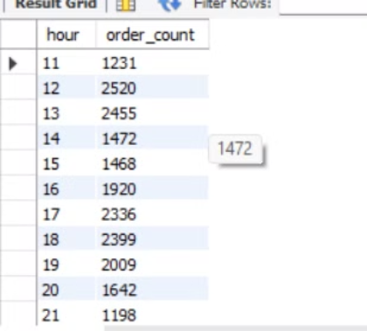
Orders By Hour Of the Day
OUTPUT
This information can help the business optimize staffing and inventory to meet demand throughout the day.

Slide 12
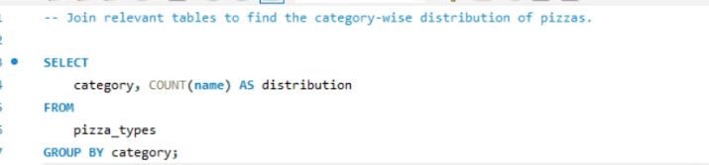
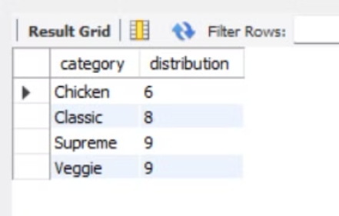
Category-Wise Pizza Order Distribution
OUTPUT
Knowing the category-wise distribution of pizzas helps in understanding customer preferences, optimizing the menu, and targeting marketing efforts to boost sales in specific categories.

Slide 13
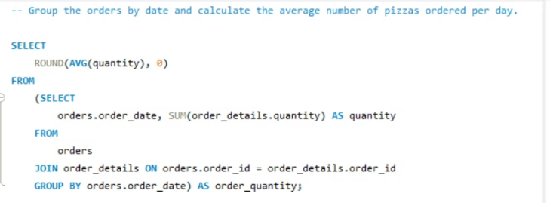
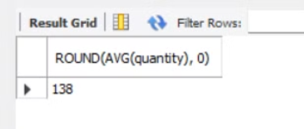
Average Daily Pizza Orders
OUTPUT
Understanding the average daily orders can help the business optimize operations, ensuring they have the right resources to meet customer demand efficiently.

Slide 14
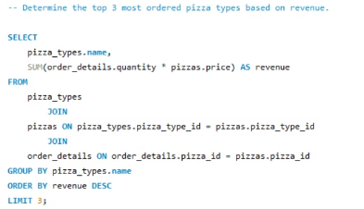
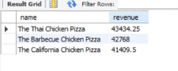
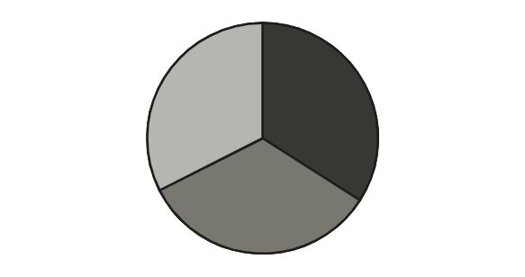
Top 3 Most Ordered Pizza Types by Revenue
The Thai Chicken Pizza
The Barbecue Chicken Pizza
The California Chicken Pizza
This pie chart shows the top 3 most ordered pizza types based on the revenue they generated.

Slide 15
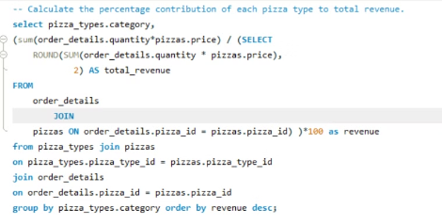

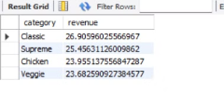
Percentage Contribution of Pizza Types to Total Revenue
classic
supreme
chicken
veggie
This pie chart shows the percentage contribution of each pizza type to the total revenue generated from pizza sales. agement.

Slide 16
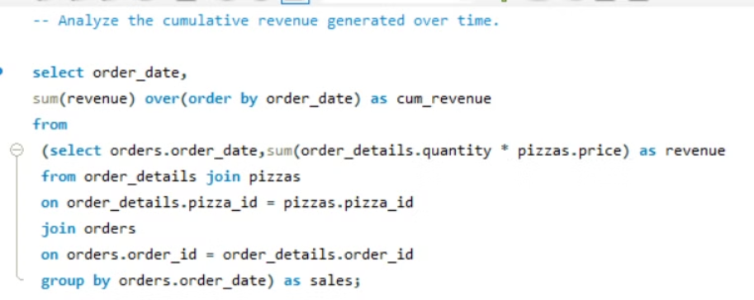
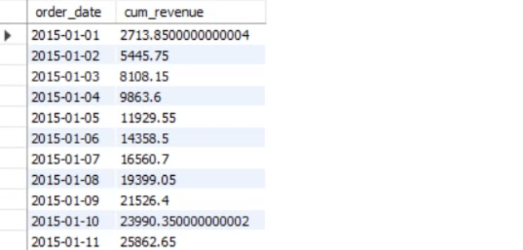
Cumulative Revenue Overtime
OUTPUT

Slide 17
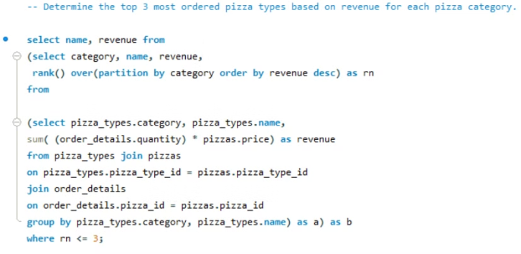
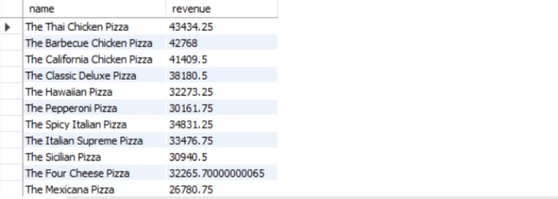
Top 3 Most Ordered Pizza Types by Revenue in Each Category
OUTPUT

Slide 18

Conclusion and Key Takeaways
1
Data-Driven Decisions
2
Continuous Improvement
The insights from this pizza sales analysis can inform strategic decisions to optimize operations, pricing, product mix, and more.
Regularly monitoring and analyzing pizza sales data will enable the business to identify trends, test new initiatives, and drive continuous improvement.
3
Customer-Centric Focus
Understanding customer preferences and behaviors is key to delivering a superior dining experience and maintaining a competitive edge.

